Slide 1
CS 484
Introduction to Machine Learning
Week 5, February 18, 2021
Spring Semester 2021

Slide 2
Week 5: Decision Tree
Motivation
CART Algorithm
Cluster Profile
Chapter 5 of the Machine Learning book

Slide 3
Getting Started: Predict Mortgage Default
Approval Decision
Loan Application
A loan officer needs a rule-based decision scheme to predict the likelihood of default.
A rule-based decision is like this: If an application exhibits these characteristics, then the likelihood of default is p%.
In other words, the loan officer will construct a sketch of an applicant who has a high likelihood to default a loan.

Slide 4
Variables in the Home Equity Dataset
Variable | Role | Level | Description
BAD | Target | Binary | Status of loan: 1 = applicant defaulted on the loan or is seriously delinquent 0 = applicant paid the loan on schedule
CLAGE | Input | Interval | Age of oldest credit line (months)
CLNO | Input | Interval | Number of credit lines
DEBTINC | Input | Interval | Debt-to-income ratio
DELINQ | Input | Nominal | Number of delinquent credit lines
DEROG | Input | Nominal | Number of major derogatory reports
JOB | Input | Nominal | Occupation category (Mgr, Office, Other, ProfExe, Sales, Self)
LOAN | Input | Interval | Requested loan amount (dollars)
MORTDUE | Input | Interval | Amount due on existing mortgage (dollars)
NINQ | Input | Nominal | Number of recent credit inquiries
REASON | Input | Binary | Reason for loan: DebtCon = debt consolidation; HomeImp = home improvement
VALUE | Input | Interval | Value of current property (dollars)
YOJ | Input | Interval | Number of years at present job

Slide 5
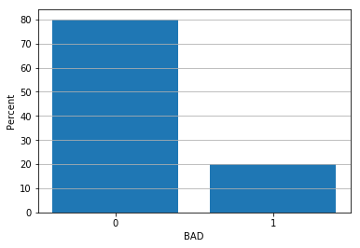
Overall Default Rate
BAD Count Percent
0 4771 80.050336
1 1189 19.949664
All 5960 100.000000
There are 5,960 applicants.
1,189 applicants have defaulted on the loan or is seriously delinquent.
Overall default rate is 19.95%.
The goal is to identify segments of applicants such that the default rates in the segments are substantially different from the overall rate of 19.95%.
Week 5 HMEQ CART.py

Slide 6
How Is the Loan Default Rate Vary?
Interval: CLAGE, CLNO, DEBTINC, LOAN, MORTDUE, VALUE
Scatterplot – the vertical axis represents the default rates
Nominal: DELINQ, DEROG, and NINQ
Bar chart – the bars represent the default rates

Slide 7
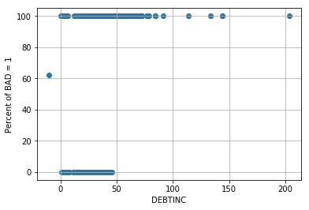
DEBTINC: Debt-to-Income Ratio
When DEBTINC is missing, the default rate is about 60%.
When DEBTINC > 50, the default rates are 100%.
If we divide the data using DEBTINC > 50 or DEBTINC is missing, then we may get two segments which have very different default rates.
Week 5 HMEQ CART.py

Slide 8
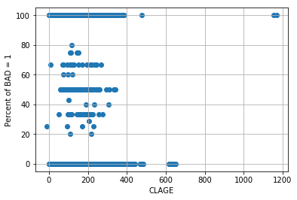
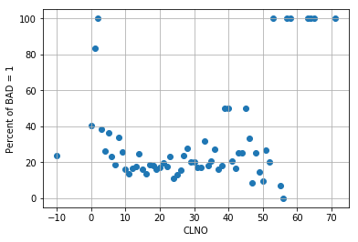
CLAGE: Age of oldest credit line (months) CLNO: Number of credit lines
No Visible Segments
No Visible Segments

Slide 9
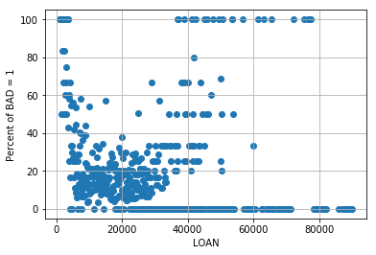
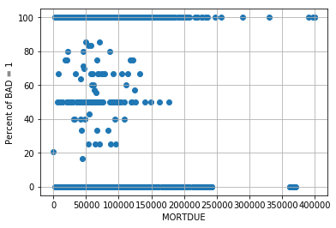
LOAN: Requested loan amount MORTDUE: Amount due on existing mortgage
No Visible Segments
No Visible Segments

Slide 10
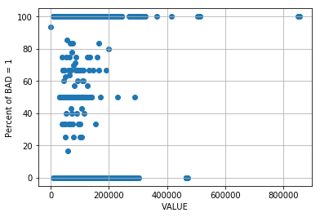
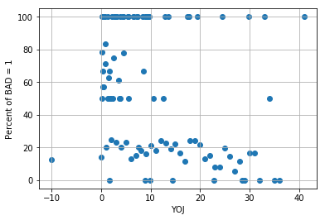
VALUE: Value of current property YOJ: Number of years at present job
No Visible Segments
No Visible Segments

Slide 11
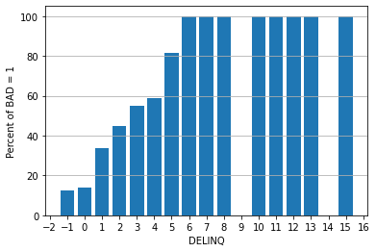
DELINQ: Number of delinquent credit lines
When DELINQ is missing or equals to 0, the default rates are lower than the average.
When DELINQ  1, the default rates steadily increase above the average as DELINQ increases.
When DELINQ  6, the default rates stays constantly at 100%.

Slide 12
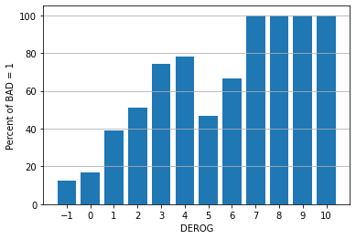
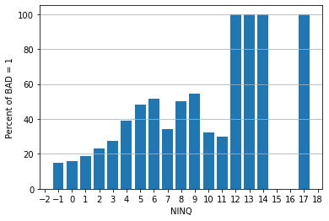
DEROG: Number of major derogatory reports NINQ: Number of recent credit inquiries
DEROG = -1 or 0 versus DEROG  1
NINQ = -1,0, or 1 versus NINQ  2

Slide 13
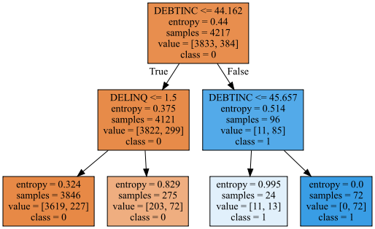
What Does Decision Tree Try to Achieve?
Decision Tree uses the features that shows the clearest evidence for dividing the observations into disjoint segments.
Decision Tree starts from the feature that shows the most amount of evidence.
Decision Tree uses a feature’s values to derive a splitting rule.

Slide 14
How are the Rules Derived?
A decision is defined by an array of a range of values of a predictor
A rule is expressed as a sequence of Boolean decisions connected by the AND operator
A segment is defined by applying rules sequentially
An observation is assigned to one of the mutually exclusive segments

Slide 15
Ten-Second Description of Decision Tree …
A decision tree model is a collection of rules.
The rules divide the observations into disjoint segments.
Distribution of the target values in the segments are noticeably different.
Also known as Recursive (Data) Partitioning in other fields (e.g., medical or public health)

Slide 16
What is in a Tree Diagram?
Read from Top, and Go Down!

Slide 17
Terminology
Each box in the tree diagram is called a Node.
Each line in the tree diagram is called a Branch or a Split.
A tree diagram is displayed in layers, the number of layers minus one is the Depth (e.g., this tree has 3 layers but only 2 levels deep)
The predictor used to create a branch is called the Branching Variable or the Splitting Variable
DEBTINC is the splitting variable in the first level
DELINQ is a splitting variable in the second level and DEBTINC is used again as another splitting variable

Slide 18
Terminology
A Parent Node is a node where the branch comes from.
A Child Node is a node where the branch goes into.
The Root Node is the node where there are no branches that go into it.
There is only one Root Node in a Tree Diagram.
The Root Node is at Level 0
A Terminal Node is a node where there no branches that come from it.

Slide 19
Describe Terminal Nodes
Describe the terminal node by the decision rule
Simplify the decision path, if necessary, by mathematically resolving any logical redundancy
Trace the decision rule that runs from the Root Node to the terminal node
Select a terminal node

Slide 20
Four Terminal Nodes Are …
DEBTINC <= 44.162 and DELINQ <= 1.5
DEBTINC <= 44.162 and DELINQ > 1.5
DEBTINC > 44.162 and DEBTINC <= 45.657
An equivalent rule is 44.162 < DEBTINC <= 45.657
DEBTINC > 44.162 and DEBTINC > 45.657
When DEBTINC > 45.657, the condition DEBTINC > 44.162 is redundant
Thus, the simplified rule is DEBTINC > 45.657

Slide 21
Four Decision Rules
Decision Rule | N Observations | % Obs. BAD = 1 | Predicted Class | Entropy
DEBTINC ≤ 44.162 and DELINQ ≤ 1.5 | 3,846 | 227 / 3846 = 5.90% | BAD = 0 | 0.324
DEBTINC ≤ 44.162 and DELINQ > 1.5 | 275 | 72 / 275 = 26.18% | BAD = 0 | 0.829
44.162 < DEBTINC ≤ 45.657 | 24 | 13 / 24 = 54.17% | BAD = 1 | 0.995
DEBTINC > 45.657 | 72 | 72 / 72 = 100% | BAD = 1 | 0

Slide 22
Popular Decision Tree Algorithms
CART – Classification And Regression Trees
Leo Breiman, Jerome Friedman, Charles J. Stone, Richard A. Olshen (1984). Classification and Regression Trees, Belmont, California: Wadsworth International Group.
CHAID – CHi-squared Automatic Interaction Detector
Gordon V. Kass (1980). An Explanatory Technique for Investigating Large Quantities of Categorical Data, Applied Statistics (Journal of the Royal Statistical Society, Series C), volume 29, number 2, pages 119-127.
The CHAID method will use the Statistical Test based criteria. Due to our tight class schedule, we will not cover CHAID.

Slide 23
CART Algorithm: History
The CART algorithm was first introduced in the 1984 book by Leo Breiman, Jerome Friedman, Charles J. Stone, and Richard A. Olshen
Leo Breiman (1928 – 2005), Professor Emeritus of Statistics at University of California, Berkeley
Jerome Friedman (1939 – ), Professor of Statistics at Stanford University, https://statweb.stanford.edu/~jhf/
Charles Stone, Professor Emeritus of Statistics at University of California, Berkeley, http://vcresearch.berkeley.edu/faculty/charles-stone
Richard A. Olshen (1942 – ), Professor of Health Research and Policy, Stanford University, http://statweb.stanford.edu/~olshen/
The first commercial software is CART® of the Salford Systems
Charles Stone on Data Mining Tool CART ( https://www.youtube.com/watch?v=aDy6mzbS8rs )

Slide 24
CART Algorithm: Overview
Classification Tree is for categorical target variables.
Regression Tree is for interval target variables.
CART is supposed to deal with the missing values in predictors.
CART should not be affected by outliers and collinearities.
Outliers are put aside into a separate node and are not used in splitting.
CART is invariant under any monotone transformation of predictors.
For example, taking the logarithm, the square, or the square root of predictors has no effect on the overall shape of the tree produced.

Slide 25
CART Algorithm: Technical Overview
Consider target values in a parent node
Assume target values come from a mixture of populations
Create a rule to divide these values into two child nodes
Make target distribution across two child nodes more different
Each child node later becomes a parent

Slide 26
CART Algorithm: Technical Details
Start with the first predictor, select a value to split data in the node into two partitions.
Interval or Ordinal Predictors: {x: x < a} and {x: x ≥ a} where a is a value
Nominal Predictor: {x: x  A} and {x: x  A} where A is a subset of values
Apply the Goodness of Split Criterion, calculate the impurity of the partitions, and evaluate the reduction of impurity from the parent node.
Select the split partition that results in the largest reduction of impurity and labels it the “best” split for the predictor.

Slide 27
CART Algorithm: Technical Details
Repeat steps 1 to 3 for each remaining predictors. Go to step 5 when “best” splits are found for all predictors.
Ranks all the “best” split of each predictor according to the reduction in impurity achieved by each split.
Select the predictor and its split partition that most reduced the impurity of the parent node.
Assign observations to one of the two child nodes.
Determine whether the child nodes are terminal based on the Stopping Criteria
Repeat steps 1 to 8 for each non-terminal child nodes.

Slide 28
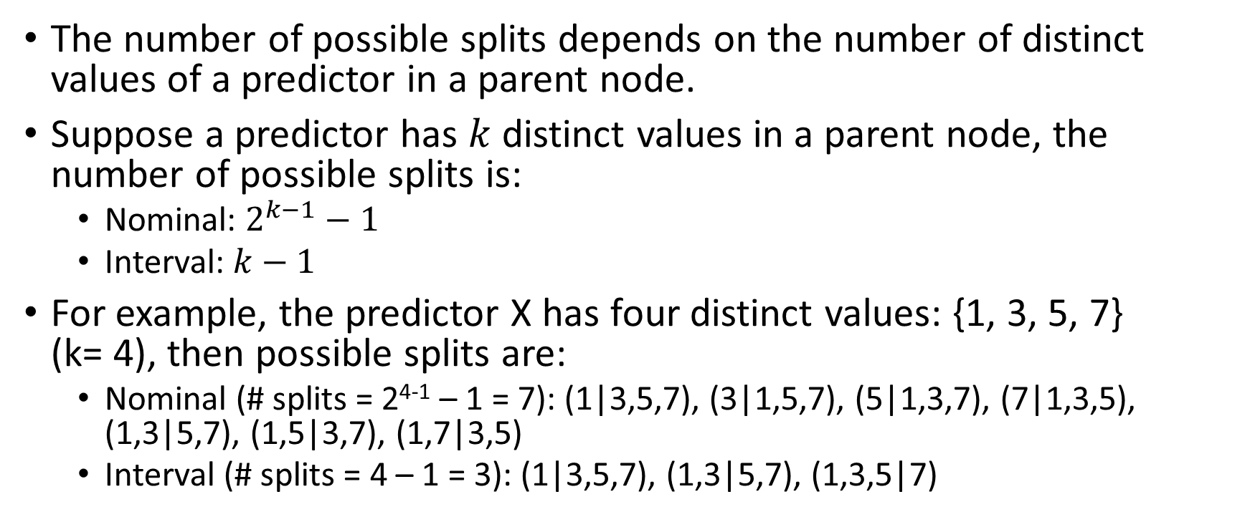
CART Algorithm: Number of Possible Splits
The number of possible splits depends on the number of distinct values of a predictor in a parent node.
Suppose a predictor has $k$ distinct values in a parent node, the number of possible splits is:
Nominal: $2^{k−1}−1$
Interval: $k−1$
For example, the predictor X has four distinct values: {1, 3, 5, 7} (k= 4), then possible splits are:
Nominal (# splits = 2⁴⁻¹ – 1 = 7): (1|3,5,7), (3|1,5,7), (5|1,3,7), (7|1,3,5), (1,3|5,7), (1,5|3,7), (1,7|3,5)
Interval (# splits = 4 – 1 = 3): (1|3,5,7), (1,3|5,7), (1,3,5|7)

Slide 29
Impurity Metric
Categorical Target Variable
Entropy: $−\sum_{j=1}^{k}{p_{ij}\log_{2}\left(p_{ij}\right)}$
Entropy: −∑_(𝑗=1)^𝑘▒〖𝑝_𝑖𝑗 log_2⁡(𝑝_𝑖𝑗 ) 〗
Interval Target Variable
Residual Sum of Squares: $\sum_{case j}{{\left(y_{j}−{\overline{y}}_{\left[j\right]}\right)}^{2}}$ where ${\overline{y}}_{\left[j\right]}$ is the mean of the target variable in the node that case j belongs to
Residual Sum of Squares: ∑_(case 𝑗)▒(𝑦_𝑗−𝑦 ̅_[𝑗] )^2 where 𝑦 ̅_[𝑗] is the mean of the target variable in the node that case j belongs to
Gini Index: $1−\sum_{j=1}^{k}{p_{ij}^{2}}$
Gini Index: 1−∑_(𝑗=1)^𝑘▒𝑝_𝑖𝑗^2

Slide 30
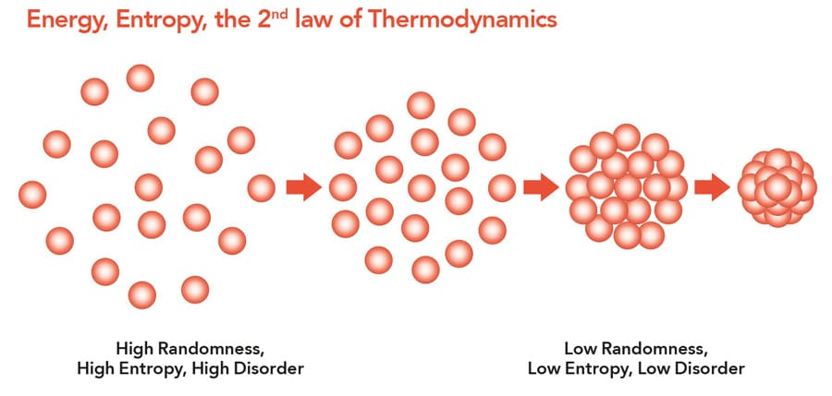
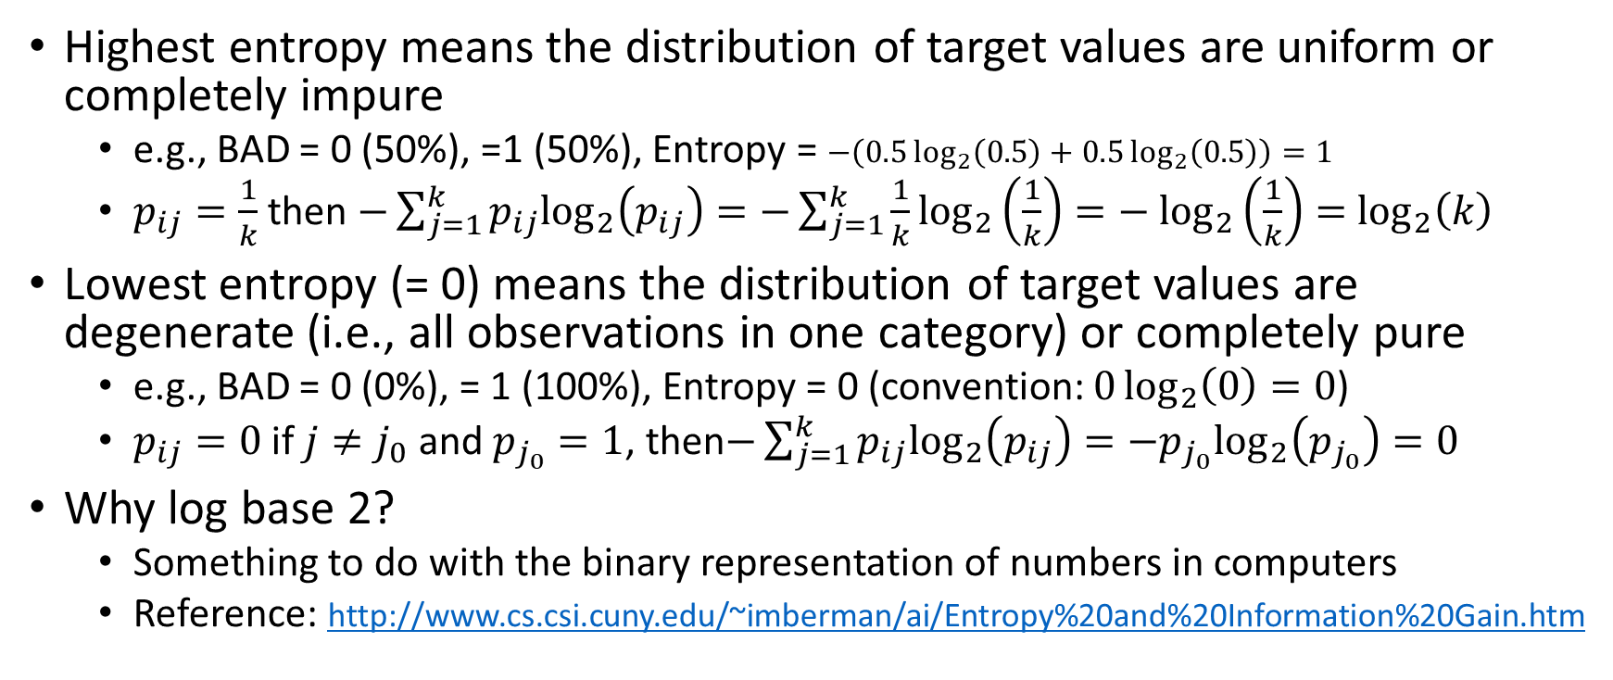
CART Algorithm: Entropy
Highest entropy means the distribution of target values are uniform or completely impure
e.g., BAD = 0 (50%), =1 (50%), Entropy = $−\left(0.5\log_{2}\left(0.5\right)+0.5\log_{2}\left(0.5\right)\right)=1$
$p_{ij}=\frac{1}{k}$ then $−\sum_{j=1}^{k}{p_{ij}\log_{2}\left(p_{ij}\right)}=−\sum_{j=1}^{k}{\frac{1}{k}\log_{2}\left(\frac{1}{k}\right)}=−$ $\log_{2}\left(\frac{1}{k}\right)=$ $\log_{2}\left(k\right)$
Lowest entropy (= 0) means the distribution of target values are degenerate (i.e., all observations in one category) or completely pure
e.g., BAD = 0 (0%), = 1 (100%), Entropy = 0 (convention: $0\log_{2}\left(0\right)=0$)
$p_{ij}=0$ if $j≠j_{0}$ and $p_{j_{0}}=1$, then$−\sum_{j=1}^{k}{p_{ij}\log_{2}\left(p_{ij}\right)}=−p_{j_{0}}\log_{2}\left(p_{j_{0}}\right)=0$
Why log base 2?
Something to do with the binary representation of numbers in computers
Reference: http://www.cs.csi.cuny.edu/~imberman/ai/Entropy%20and%20Information%20Gain.htm

Slide 31
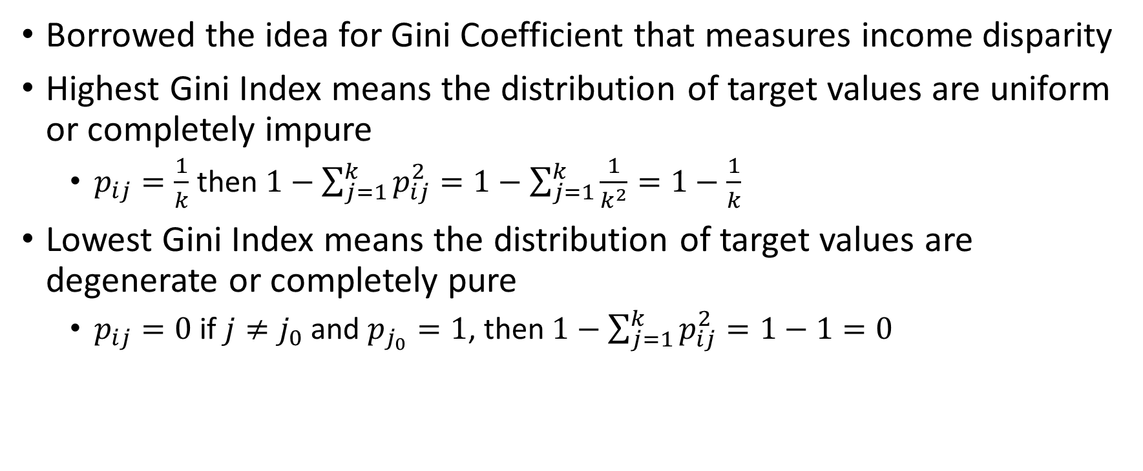
CART Algorithm: Gini Index
Borrowed the idea for Gini Coefficient that measures income disparity
Highest Gini Index means the distribution of target values are uniform or completely impure
$p_{ij}=\frac{1}{k}$ then $1−\sum_{j=1}^{k}{p_{ij}^{2}}=1−\sum_{j=1}^{k}{\frac{1}{k^{2}}}=1−\frac{1}{k}$
Lowest Gini Index means the distribution of target values are degenerate or completely pure
$p_{ij}=0$ if $j≠j_{0}$ and $p_{j_{0}}=1$, then $1−\sum_{j=1}^{k}{p_{ij}^{2}}=1−1=0$

Slide 32
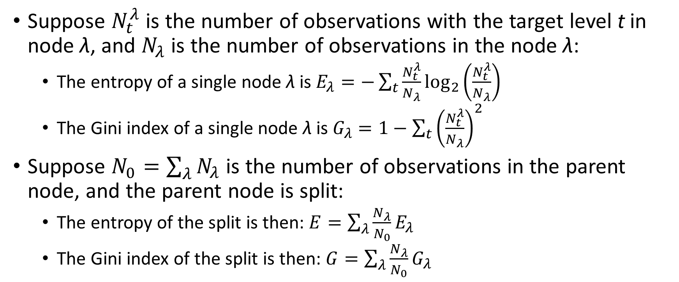
Entropy and Gini Index for a Split
Suppose $N_{t}^{λ}$ is the number of observations with the target level t in node λ, and $N_{λ}$ is the number of observations in the node λ:
The entropy of a single node λ is $E_{λ}=−\sum_{t}{\frac{N_{t}^{λ}}{N_{λ}}}\log_{2}\left(\frac{N_{t}^{λ}}{N_{λ}}\right)$
The Gini index of a single node λ is $G_{λ}=1−\sum_{t}{{\left(\frac{N_{t}^{λ}}{N_{λ}}\right)}^{2}}$
Suppose $N_{0}=\sum_{λ}{N_{λ}}$ is the number of observations in the parent node, and the parent node is split:
The entropy of the split is then: $E=\sum_{λ}{\frac{N_{λ}}{N_{0}}E_{λ}}$
The Gini index of the split is then: $G=\sum_{λ}{\frac{N_{λ}}{N_{0}}G_{λ}}$

Slide 33
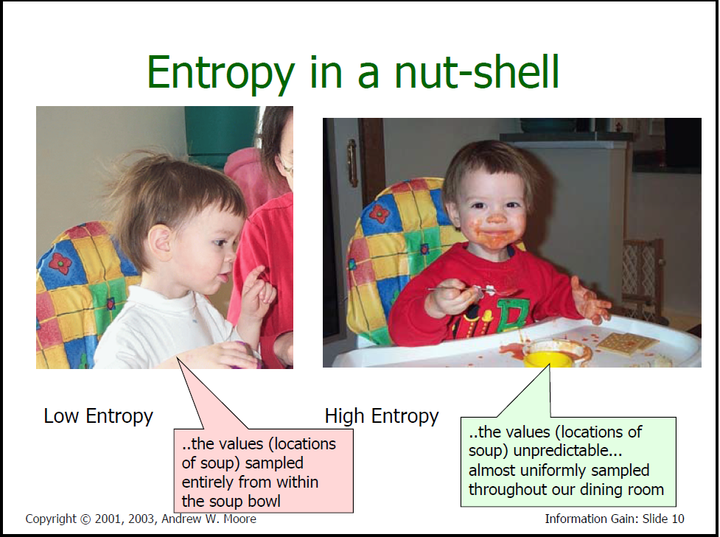
Entropy in a Nut-Shell ☺
Source: https://www.autonlab.org/_media/tutorials/infogain11.pdf, September 19, 2018 (no longer found)

Slide 34
Binary Target, Nominal Predictor
Twenty observations
CaseID – observation identifier
A – Nominal predictor with three categories: Sugar, Pepper, and Salt
B – Binary target with two categories: No and Yes
CaseID | A | B |  | CaseID | A | B
1 | Pepper | No |  | 11 | Pepper | Yes
2 | Salt | No |  | 12 | Sugar | Yes
3 | Pepper | Yes |  | 13 | Sugar | No
4 | Pepper | Yes |  | 14 | Pepper | Yes
5 | Salt | Yes |  | 15 | Salt | No
6 | Salt | No |  | 16 | Pepper | Yes
7 | Salt | No |  | 17 | Pepper | Yes
8 | Salt | No |  | 18 | Pepper | Yes
9 | Pepper | Yes |  | 19 | Sugar | Yes
10 | Pepper | Yes |  | 20 | Salt | No

Slide 35
Step 0: Entropy of the Root Node
Build a contingency table
Entropy of the Root Node - ((8/20) * log₂(8/20) + (12/20) * log₂(12/20)) = 0.9709505944547
A | B
 | No | Yes | Total
Sugar | 1 | 2 | 3
Pepper | 1 | 9 | 10
Salt | 6 | 1 | 7
Total | 8 | 12 | 20

Slide 36
Step 0.1: Possible Split 1
Consider {Sugar and Pepper} and {Salt}
{Sugar and Pepper}: entropy = - ((2/13) * log₂(2/13) + (11/13) * log₂(11/13)) = 0.6193821946788
{Salt}: entropy = - ((6/7) * log₂(6/7) + (1/7) * log₂(1/7)) = 0.4010507031511
Split: entropy = (13/20) * 0.6193821946788 + (7/20) * 0.4010507031511 = 0.6096838990450
A | B
 | No | Yes | Total
Sugar & Pepper | 2 | 11 | 13
Salt | 6 | 1 | 7
Total | 8 | 12 | 20

Slide 37
Step 0.2: Possible Split 2
Consider {Sugar and Salt} and {Pepper}
{Sugar and Salt}: entropy = - ((7/10) * log₂(7/10) + (3/10) * log₂(3/10)) = 0.8812908992307
{Pepper}: entropy = - ((1/10) * log₂(1/10) + (9/10) * log₂(9/10)) = 0.4689955935893
Split: entropy = (10/20) * 0.8812908992307 + (10/20) * 0.4689955935893 = 0.6751432464100
A | B
 | No | Yes | Total
Sugar & Salt | 7 | 3 | 10
Pepper | 1 | 9 | 10
Total | 8 | 12 | 20

Slide 38
Step 0.3: Possible Split 3
Consider {Sugar} and {Pepper and Salt}
{Sugar}: entropy = - ((1/3) * log₂(1/3) + (2/3) * log₂(2/3)) = 0.9182958340545
{Pepper and Salt}: entropy = - ((7/17) * log₂(7/17) + (10/17) * log₂(10/17)) = 0.9774178175282
Split: entropy = (3/20) * 0.9182958340545 + (17/20) * 0.9774178175282 = 0.9685495200071
A | B
 | No | Yes | Total
Sugar | 1 | 2 | 3
Pepper and Salt | 7 | 10 | 17
Total | 8 | 12 | 20

Slide 39
Step 1: Determine Optimal Split
{Root}: Entropy = 0.9709505944547
{Sugar and Pepper}, {Salt}:
Entropy = 0.6096838990450
Reduction = 0.9709505944547 - 0.6096838990450 = 0.3612666954097
{Sugar and Salt}, {Pepper}:
Entropy = 0.6751432464100
Reduction = 0.9709505944547 - 0.6751432464100 = 0.2958073480447
{Sugar}, {Pepper and Salt}:
Entropy = 0.9685495200071
Reduction = 0.9709505944547 - 0.9685495200071 = 0.0024010744476
The split {Sugar and Pepper}, {Salt} gives the largest reduction in entropy.
The child nodes in the first split are {Sugar and Pepper} and {Salt}.

Slide 40
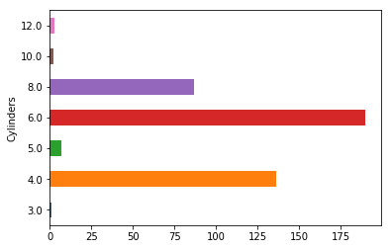
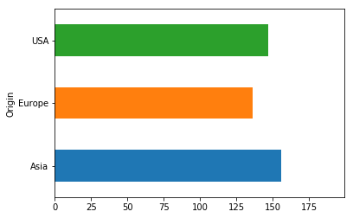
Cars: Step-by-Step Calculation
Week 5 StepByStep.py
Data is cars.csv
Ordinal predictor is Cylinders
3, 4, 5, 6, 8, 10, 12
Categorical target is Origin
Asia, Europe, USA
Use observations where both Cylinders and Origin are not missing
426 observations
Two observations with missing number of cylinders – Mazda RX-8 uses a rotary engine which has no cylinders

Slide 41
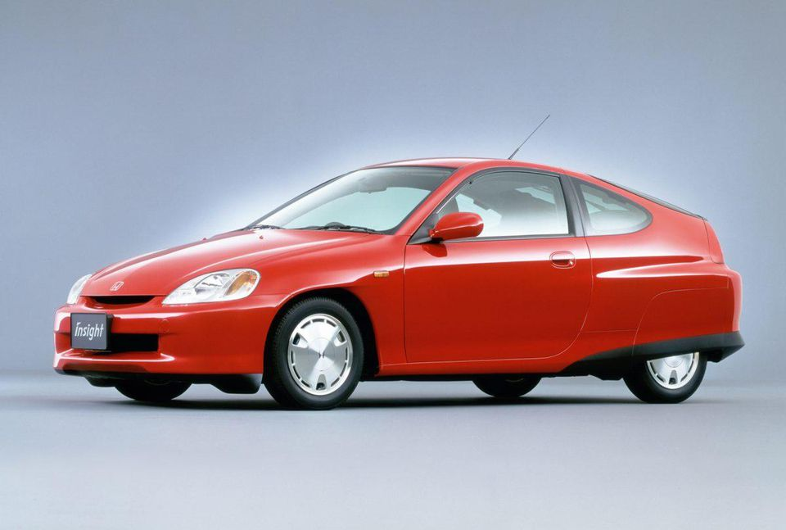
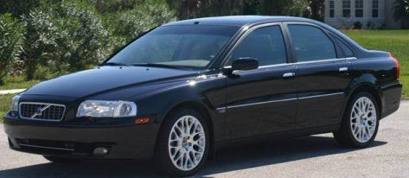

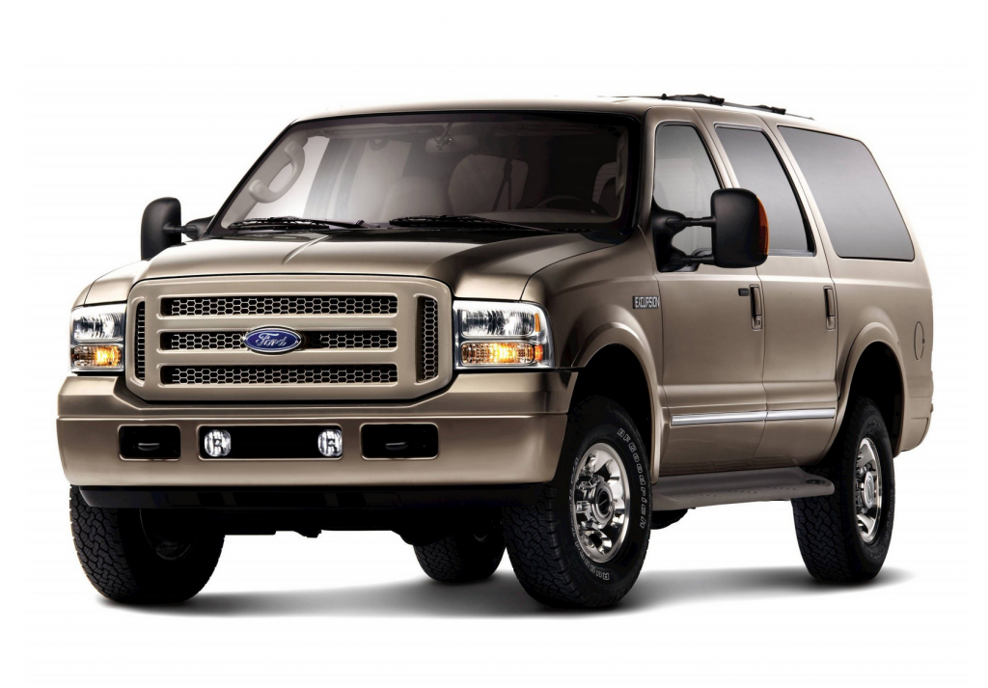
Cars: Step-by-Step Calculation
Cylinders | Origin
 | Asia | Europe | USA | All
3 | 1 | 0 | 0 | 1
4 | 74 | 25 | 37 | 136
5 | 0 | 7 | 0 | 7
6 | 69 | 54 | 67 | 190
8 | 12 | 34 | 41 | 87
10 | 0 | 0 | 2 | 2
12 | 0 | 3 | 0 | 3
All | 156 | 123 | 147 | 426
First Generation Honda Insight 3-cylinder
Volvo S80: 5 Cylinders
Volkswagen Phaeton 12 Cylinders
Ford Excursion 10 Cylinders

Slide 42
Step 0: Entropy of the Root Node
Entropy
= - ((156/426) * log₂(156/426) + (123/426) * log₂(123/426) + (147/426) * log₂(147/426))
= 1.57789
Cylinders | Origin
 | Asia | Europe | USA | All
3 | 1 | 0 | 0 | 1
4 | 74 | 25 | 37 | 136
5 | 0 | 7 | 0 | 7
6 | 69 | 54 | 67 | 190
8 | 12 | 34 | 41 | 87
10 | 0 | 0 | 2 | 2
12 | 0 | 3 | 0 | 3
All | 156 | 123 | 147 | 426

Slide 43
Step 0.n: Six Possible Splits on Cylinders
Split | Entropy
(3), (4, 5, 6, 8, 10, 12) | 1.57448
(3, 4), (5, 6, 8, 10, 12) | 1.52877
(3, 4, 5), (6, 8, 10, 12) | 1.54043
(3, 4, 5, 6), (8, 10, 12) | 1.52407 | Optimal Split since it yields lowest Entropy
(3, 4, 5, 6, 8), (10, 12) | 1.56939
(3, 4, 5, 6, 8, 10), (12) | 1.56518

Slide 44
Step 1: Optimal Split on Cylinders
Cylinders | Origin
 | Asia | Europe | USA | All
3, 4 ,5 ,6 | 144 | 86 | 104 | 334
8, 10, 12 | 12 | 37 | 43 | 92
All | 156 | 123 | 147 | 426
The differences between the two distributions are more obvious on the percentage scale
Cylinders | Origin
 | Asia | Europe | USA | All
3, 4 ,5 ,6 | 43% | 26% | 31% | 100%
8, 10, 12 | 13% | 40% | 47% | 100%
All | 37% | 29% | 35% | 100%

Slide 45
Step 1.n: Possible Splits Vary
Cylinders | Split | Entropy
<= 7 | (3), (4, 5, 6) | 1.54781
 | (3, 4), (5, 6) | 1.52178 | Optimal Split, lowest Entropy within Cylinders <= 7
 | (3, 4, 5), (6) | 1.53338
> 7 | (8), (10, 12) | 1.41019
 | (8, 10), (12) | 1.38063 | Optimal Split, lowest Entropy within Cylinders > 7

Slide 46
Step 2: Optimal Split on Cylinders
Cylinders | Origin
 | Asia | Europe | USA | All
3, 4 | 75 (55%) | 25 (18%) | 37 (27%) | 137 (100%)
5, 6 | 69 (35%) | 61 (31%) | 67 (34%) | 197 (100%)
8, 10 | 12 (13%) | 34 (38%) | 43 (48%) | 89
12 | 0 (0%) | 3 (100%) | 0 (0%) | 3 (100%)
All | 156 (37%) | 123 (29%) | 147 (35%) | 426

Slide 47
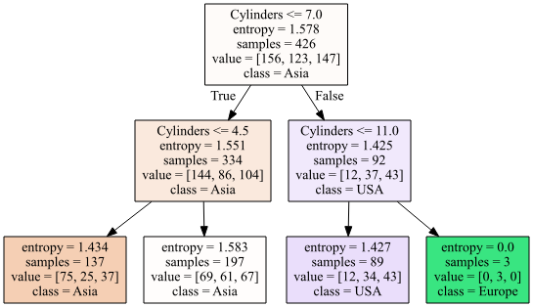
Cars: Optimal Split on Cylinders

Slide 48
CART Algorithm: Stopping Rules (Conditions that will prevent splitting a node)
Pure or Constant Node
The target variable is constant in the parent node
All predictors are constant in the parent node
Tree Size Limit
Reached the maximum tree depth
Obtained the maximum number of leaf nodes
Data Privacy
A parent node has less than the minimum parent node size (a.k.a. minimum split size)
A child node will have less than the minimum child node size (a.k.a. minimum leaf size)

Slide 49
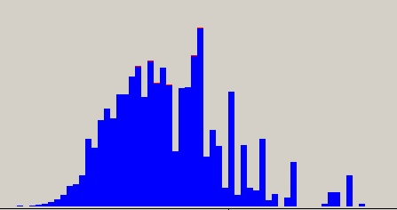
Data Preparation: Pre-Bin Interval Predictors
In order to maintain good performance, an interval predictor may be pre-binned into a large pre-determined number (e.g., 100) of equal-width bins.
These bins will define a new ordinal predictor
Decision Tree will use this new ordinal predictor instead of the original interval predictor.

Slide 50

Data Preparation: Missing Values
Missing values in target variables are always discarded

Slide 51
Predictor Missing Values Handling
Action
Treated as another distinct valid category
Merged into other categories (e.g., the mode or the neighboring category).
Advantage
The same number of observations is used for each predictor
The presence of missing values in a predictor may associate with target values

Slide 52
A Concern on Over-fitting the Data
Decision Tree is a poster child example to warn against Over-fitting
Over-fitting means the model is more complex than it should be, and it starts to pick up noise instead of signal.
An overfitted data is overly tailored to the training data and cannot handle uncertainty in future data.
Tempt to train a model well when we have many observations and many predictors
The worst situation when we selected a predictor (e.g., Case Identifier) that has unique value in each observation

Slide 53
Sharing Experience on Training A Decision Tree
Training a decision tree is an iterative task (except in homework).
First train a big tree, per my resources permit
The big tree allows me to see what predictors the tree took and how often the pure nodes occur
Should I exclude some predictors if they give me distractions instead of information? What kind of stories can I tell from this decision tree?
Do I want to keep the pure nodes? I may prefer higher accuracy if I do not plan to use the decision tree on future data.
How do I adjust the specifications to get the right tree?

Slide 54
Python Modules
sklearn.tree: Decision Trees
tree.DecisionTreeClassifier() A decision tree classifier.
tree.DecisionTreeRegressor() A decision tree regressor.
tree.export_graphviz() Export a decision tree in DOT.
graphviz: Rendering DOT
graphviz.Source() Convert DOT into a graph.
render() Render the graph into PDF.

Slide 55
The Caveat of sklearn.tree: Decision Trees
Assume all input fields are interval variables
Does not handle string input variables, thus no nominal and ordinal string
Require all observations are complete, i.e., no missing values
Does not handle missing values in input fields
Does not carry the variable names in the output
Need to re-specify the names in tree_export_graphviz() function

Slide 56
Use Decision Tree to Describe Clusters
Step
Cluster the observations
Build a decision tree, the cluster IDs as the target variable, same input fields as the clustering
Goal
Describe the majority of observations in a cluster by a decision tree rule
NOT to re-discover the clusters

Slide 57
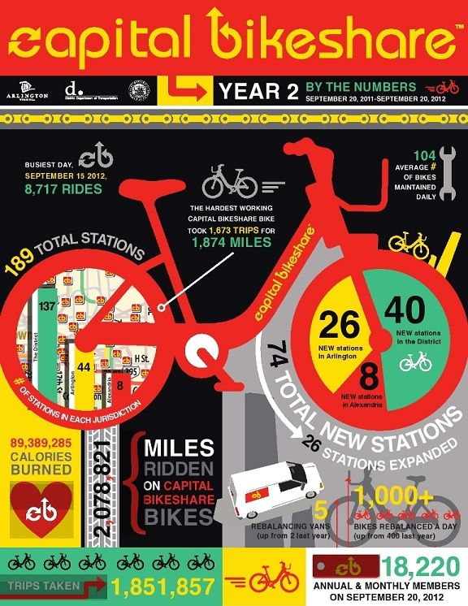
Capital Bike Share Data
Kaggle data from Capital Bikeshare program in Washington, DC
About bicycle rental usage patterns in various weather conditions between 2011 and 2012
https://www.kaggle.com/c/bike-sharing-demand.
http://archive.ics.uci.edu/ml/datasets/Bike+Sharing+Dataset

Slide 58
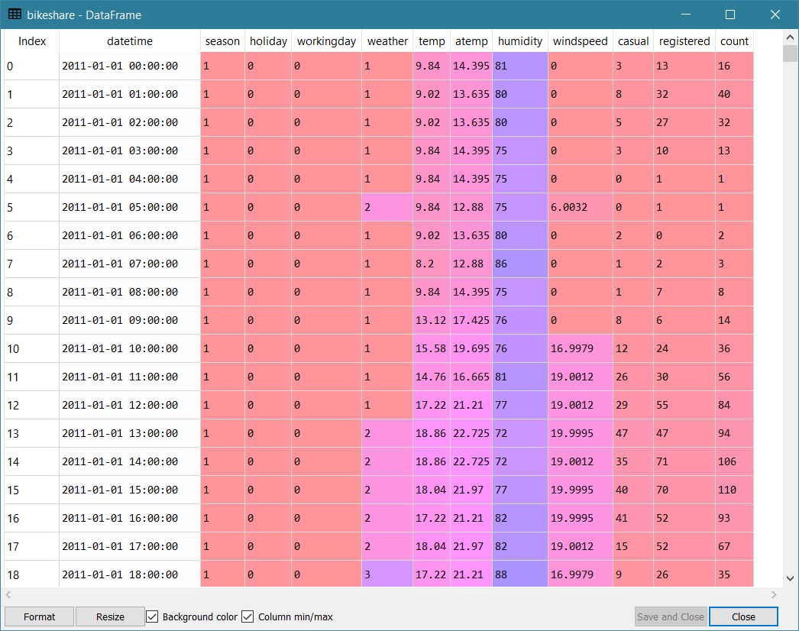
Capital Bike Share Data
BikeSharingDemand_Train.csv
Three interval predictors
temp – Hourly Temperature in Celsius
humidity – Relative Humidity in Percent
windspeed – Windspeed in km/h
Use 10,886 observations where no missing values in all three predictors

Slide 59
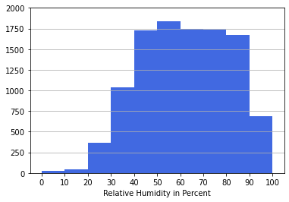
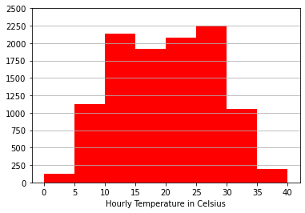
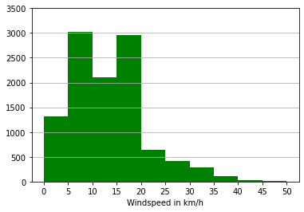
Capital Bike Share Data
0 Celsius = 32 Fahrenheit
25 Celsius = 77 Fahrenheit
40 Celsius = 104 Fahrenheit
40 km/h = 25 mph
30 km/h = 19 mph
10 km/h = 6 mph
Humidity
40% to 60% is comfortable
100% is rainy day

Slide 60
Week 5 BikeShare ClusterTree.py
# Determine the number of clusters using the Silhouette metrics
nClusters = numpy.zeros(15)
Elbow = numpy.zeros(15)
Silhouette = numpy.zeros(15)
for c in range(15):
KClusters = c + 1
nClusters[c] = KClusters
kmeans = cluster.KMeans(n_clusters=KClusters, random_state=60616).fit(trainData)
if (KClusters > 1):
Silhouette[c] = metrics.silhouette_score(trainData, kmeans.labels_)
WCSS = numpy.zeros(KClusters)
nC = numpy.zeros(KClusters)
for i in range(nObs):
k = kmeans.labels_[i]
nC[k] += 1
diff = trainData.iloc[i,] - kmeans.cluster_centers_[k]
WCSS[k] += diff.dot(diff)
Elbow[c] = 0
for k in range(KClusters):
Elbow[c] += WCSS[k] / nC[k]

Slide 61
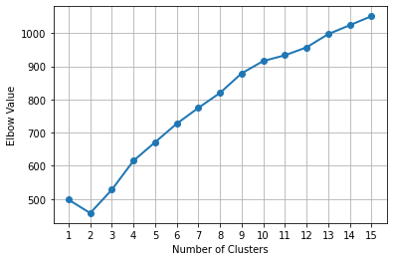
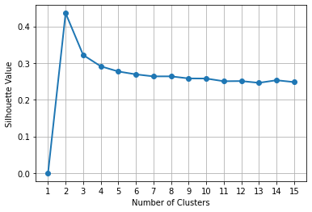
Bike Share - Clustering
Try the number of clusters from 1 to 15
The Elbow and the Silhouette metrics both determine the number of clusters to be two
The Centroids are:
Cluster | Size | temp | humidity | windspeed
0 | 5,466 | 20.076 | 78.0 | 10.25922
1 | 5,420 | 20.387 | 45.6 | 15.36113

Slide 62
Bike Share – Cluster Description
The two clusters apparently divided the data almost equally.
The mean temperatures of the two clusters are almost the same.
Cluster 0 has higher mean humidity and lower mean windspeed.
Cluster 1 has lower mean humidity and higher mean windspeed.
What kind of weather conditions do the clusters represent?
Cluster | Size | temp | humidity | windspeed
0 | 5,466 | 20.076 | 78.0 | 10.25922
1 | 5,420 | 20.387 | 45.6 | 15.36113

Slide 63
Week 5 BikeShare ClusterTree.py
# Load the TREE library from SKLEARN
from sklearn import tree
classTree = tree.DecisionTreeClassifier(criterion='entropy', max_depth=4, random_state=60616)
bikeshare_DT = classTree.fit(trainData, kmeans.labels_)
print('Accuracy of Decision Tree classifier on training set: {:.6f}' .format(classTree.score(trainData, kmeans.labels_)))
import graphviz
dot_data = tree.export_graphviz(bikeshare_DT,
out_file=None,
impurity = True, filled = True,
feature_names = ['temp', 'humidity', 'windspeed'],
class_names = ['Cluster 0', 'Cluster 1'])
graph = graphviz.Source(dot_data)
graph

Slide 64
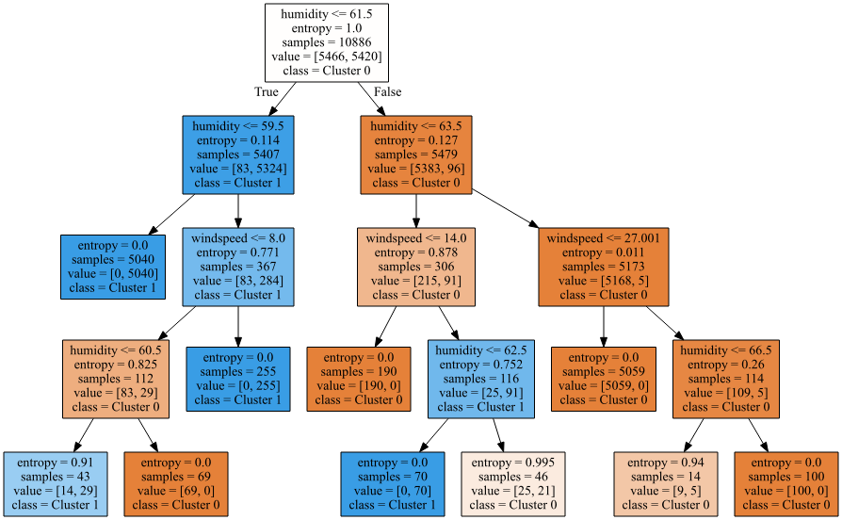
Bike Share – Decision Tree
Cluster ID is the target
temp, humidity, and windspeed are predictors
Maximum depth is 4
Splitting criterion is Entropy
Accuracy is 0.9963
99.63% of observations are correctly classified

Slide 65
Bike Share – Node Description
Rule | Entropy | Cluster 0 | Cluster 1 | Classification
humidity <= 61.5 & humidity <= 59.5 | 0 | 0 | 5040 | Cluster 1
humidity <= 61.5 & humidity > 59.5 & windspeed <= 8 & humidity <= 60.5 | 0.91 | 14 | 29 | Cluster 1
humidity <= 61.5 & humidity > 59.5 & windspeed <= 8 & humidity > 60.5 | 0 | 69 | 0 | Cluster 0
humidity <= 61.5 & humidity > 59.5 & windspeed > 8 | 0 | 0 | 255 | Cluster 1
humidity > 61.5 & humidity <= 63.5 & windspeed <= 14 | 0 | 190 | 0 | Cluster 0
humidity > 61.5 & humidity <= 63.5 & windspeed > 14 & humidity <= 62.5 | 0 | 0 | 70 | Cluster 1
humidity > 61.5 & humidity <= 63.5 & windspeed > 14 & humidity > 62.5 | 0.995 | 25 | 21 | Cluster 0
humidity > 61.5 & humidity > 63.5 & windspeed <= 27.001 | 0 | 5095 | 0 | Cluster 0
humidity > 61.5 & humidity > 63.5 & windspeed > 27.001 & humidity <= 66.5 | 0.94 | 9 | 5 | Cluster 0
humidity > 61.5 & humidity > 63.5 & windspeed > 27.001 & humidity > 66.5 | 0 | 100 | 0 | Cluster 0

Slide 66
Bike Share – Node Description
Rule | Entropy | Cluster 0 | Cluster 1 | Classification
humidity > 61.5 & humidity > 63.5 & windspeed <= 27.001 | 0 | 5095 | 0 | Cluster 0
humidity > 61.5 & humidity <= 63.5 & windspeed <= 14 | 0 | 190 | 0 | Cluster 0
humidity > 61.5 & humidity > 63.5 & windspeed > 27.001 & humidity > 66.5 | 0 | 100 | 0 | Cluster 0
humidity <= 61.5 & humidity > 59.5 & windspeed <= 8 & humidity > 60.5 | 0 | 69 | 0 | Cluster 0
humidity <= 61.5 & humidity <= 59.5 | 0 | 0 | 5040 | Cluster 1
humidity <= 61.5 & humidity > 59.5 & windspeed > 8 | 0 | 0 | 255 | Cluster 1
humidity > 61.5 & humidity <= 63.5 & windspeed > 14 & humidity <= 62.5 | 0 | 0 | 70 | Cluster 1
humidity <= 61.5 & humidity > 59.5 & windspeed <= 8 & humidity <= 60.5 | 0.91 | 14 | 29 | Cluster 1
humidity > 61.5 & humidity > 63.5 & windspeed > 27.001 & humidity <= 66.5 | 0.94 | 9 | 5 | Cluster 0
humidity > 61.5 & humidity <= 63.5 & windspeed > 14 & humidity > 62.5 | 0.995 | 25 | 21 | Cluster 0

Slide 67
Bike Share – Node Description
Rule | Classification | N Obs. | % Within Cluster
humidity > 63.5 & windspeed <= 27.001 | Cluster 0 | 5095 | 93%
61.5 < humidity <= 63.5 & windspeed <= 14 | Cluster 0 | 190 | 3%
humidity > 66.5 & windspeed > 27.001 | Cluster 0 | 100 | 2%
humidity <= 61.5 & windspeed <= 8 | Cluster 0 | 69 | 1%
humidity <= 59.5 | Cluster 1 | 5040 | 93%
59.5 < humidity <= 61.5 & windspeed > 8 | Cluster 1 | 255 | 5%
61.5 < humidity <= 62.5 & windspeed > 14 | Cluster 1 | 70 | 1%

Slide 68
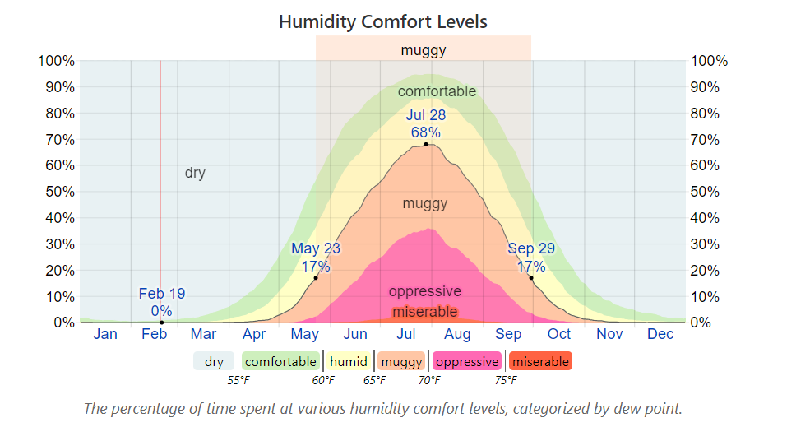
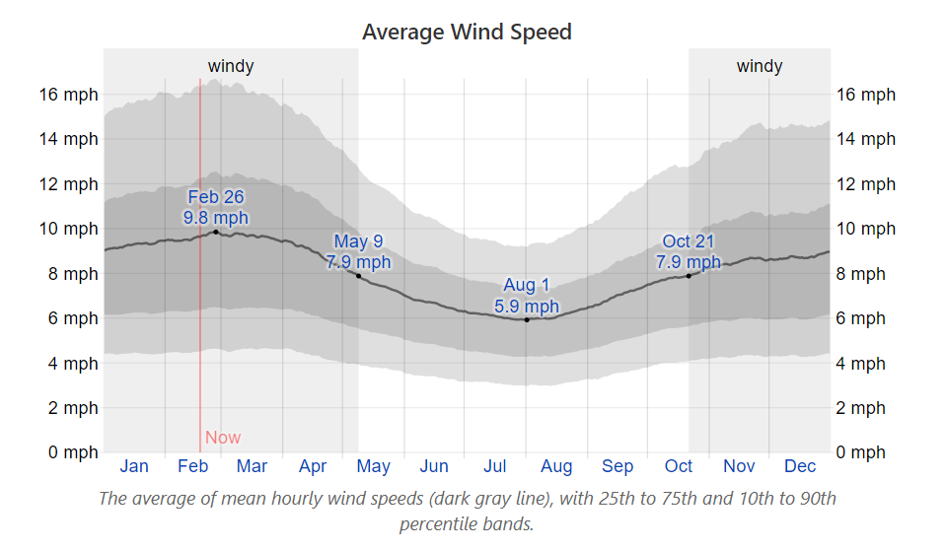
Washington, DC Climate
Source: https://weatherspark.com/y/20957/Average-Weather-in-Washington-D.C.;-United-States-Year-Round

Slide 69
Bike Share – Found Two Clusters
Cluster 0
Has 5,466 observations.
Among 93% of these observations, humidity > 63.5 and windspeed ≤ 27.001.
Cluster 0 is characterized by a relatively more humid Summer day with a warm breeze
A Tourist Season?
Cluster 1
Has 5,420 observations.
Among 93% of these observations, humidity ≤ 59.5.
Cluster 1 is characterized by a relatively less humid comfortable day in Spring or Autumn
Typical Working Days?

Slide 70
Lecture Recap
We covered an overview of the decision tree modeling.
We went through the steps of the CART algorithm.
We learned to use the sklearn.tree to build a decision tree model.
We applied the CART algorithm to describe the clustering results.

